Slide 1
Mitogenic diversity in Russians and Poles
Natalia Morozova

Slide 2
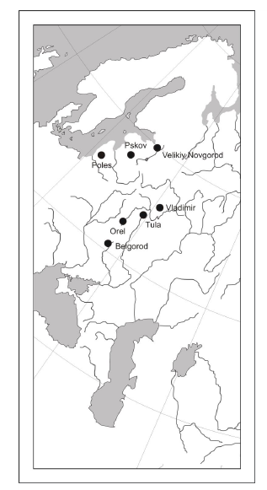
476 samples (376 Russian and 100 Polish)
Whole mtDNA instead of HVS

Slide 3
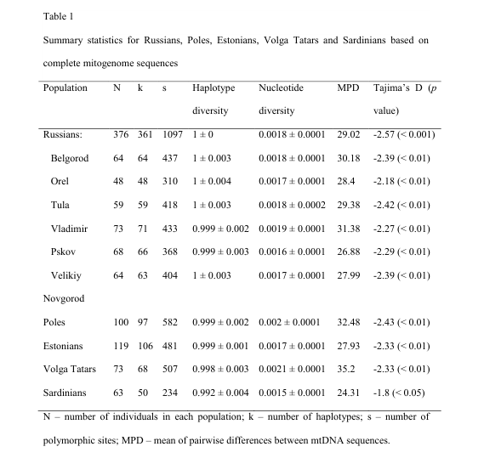
High diversity but low difference between subregions
Contradicts previous studies that show that northern Russians make a separate group that is more closely related to Estonians (possibly large sample sizes and data from more northern regions should be added)
Tajima’s D more than -2 point to recent population expansion

Slide 4
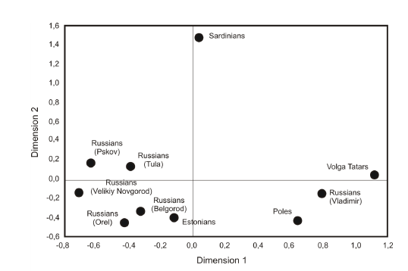

Slide 5
Episode of rapid population growth starting from ~4.3 kya (95% CI: 2.9-5.8 kya), i.e. in the Bronze Age (Kurgan model)
Corded Ware culture (also known as the Battle-Axe culture),which flourished 5.2-3.8 kya in eastern and central Europe

Slide 6
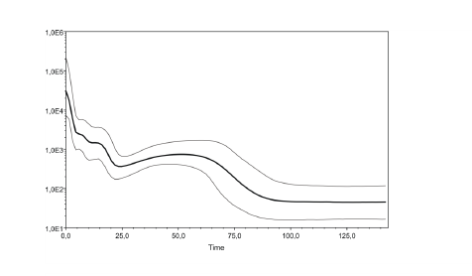
Another proof of recent post-Glacial expansion on European territory

